Slide 1
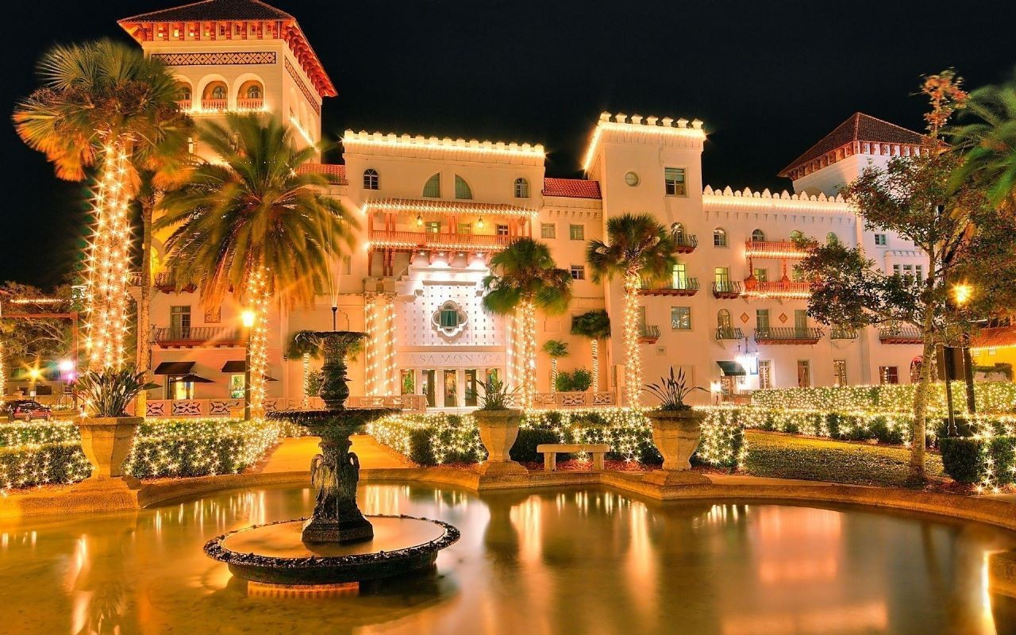
HOTEL RESERVATION USING HIBERNATE AND MAVEN
Harini Akshaya K(EBEON1222698864), Pavithra (EBEON1222704165), Vishnu Priya C (EBEON1222710971), Santhiyadevi KK (EBEON1222711073)
*****HOTEL NAME
ELITE INN*******
Guided by Varadharajan

Slide 2
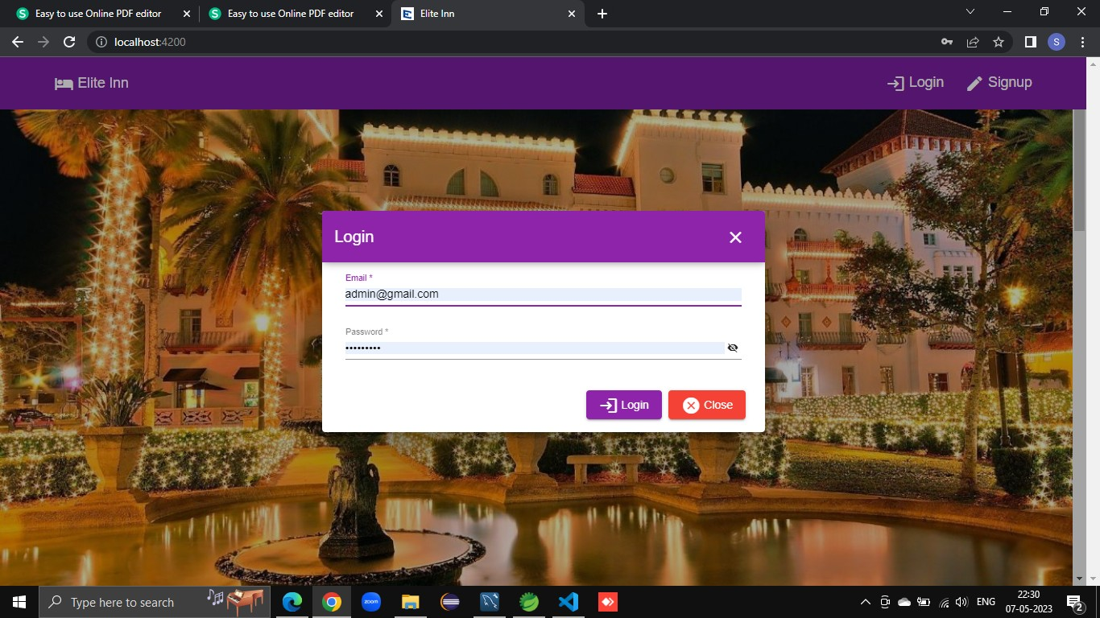
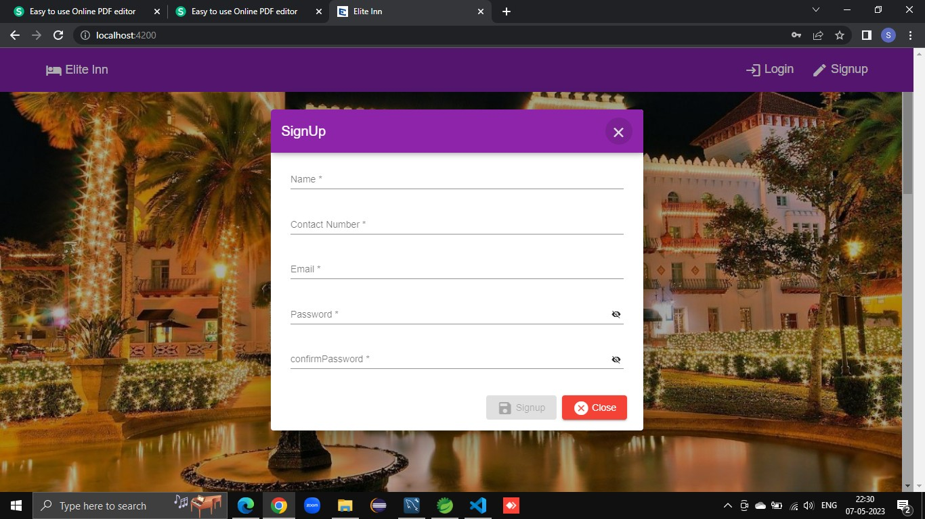
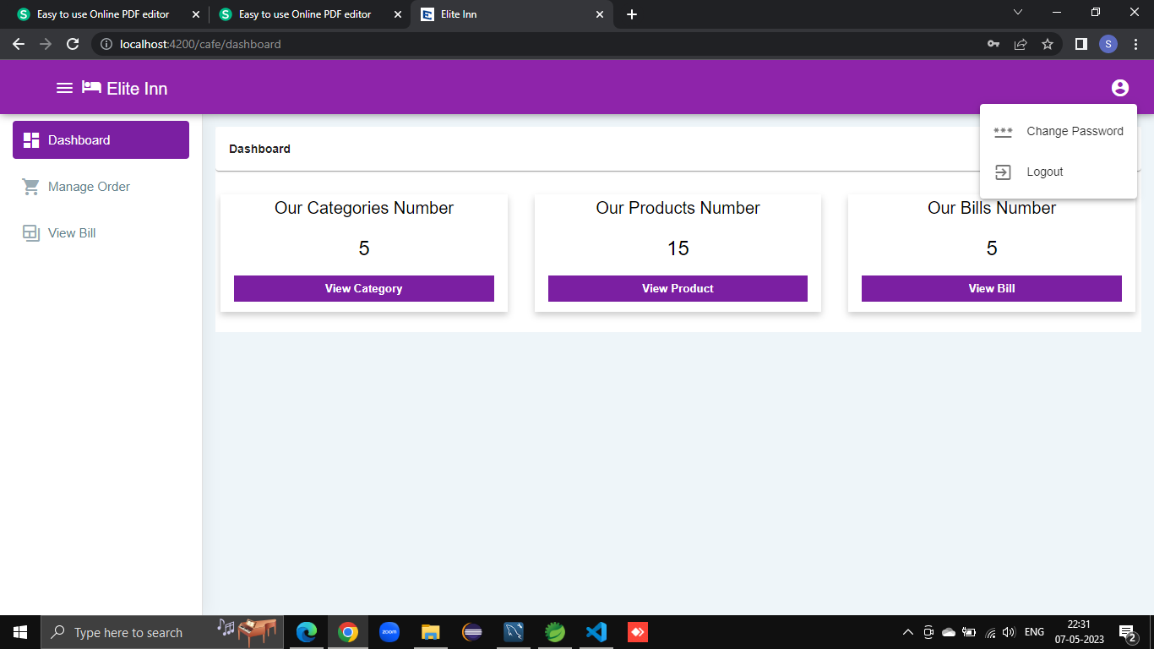
ELITE INN PROJECT ENTIRE MODULES
AUTHENTICATION MODULE :
Sign up Module
Login Module
User Module :
Manage Order
View Bill
Change Password

Slide 3
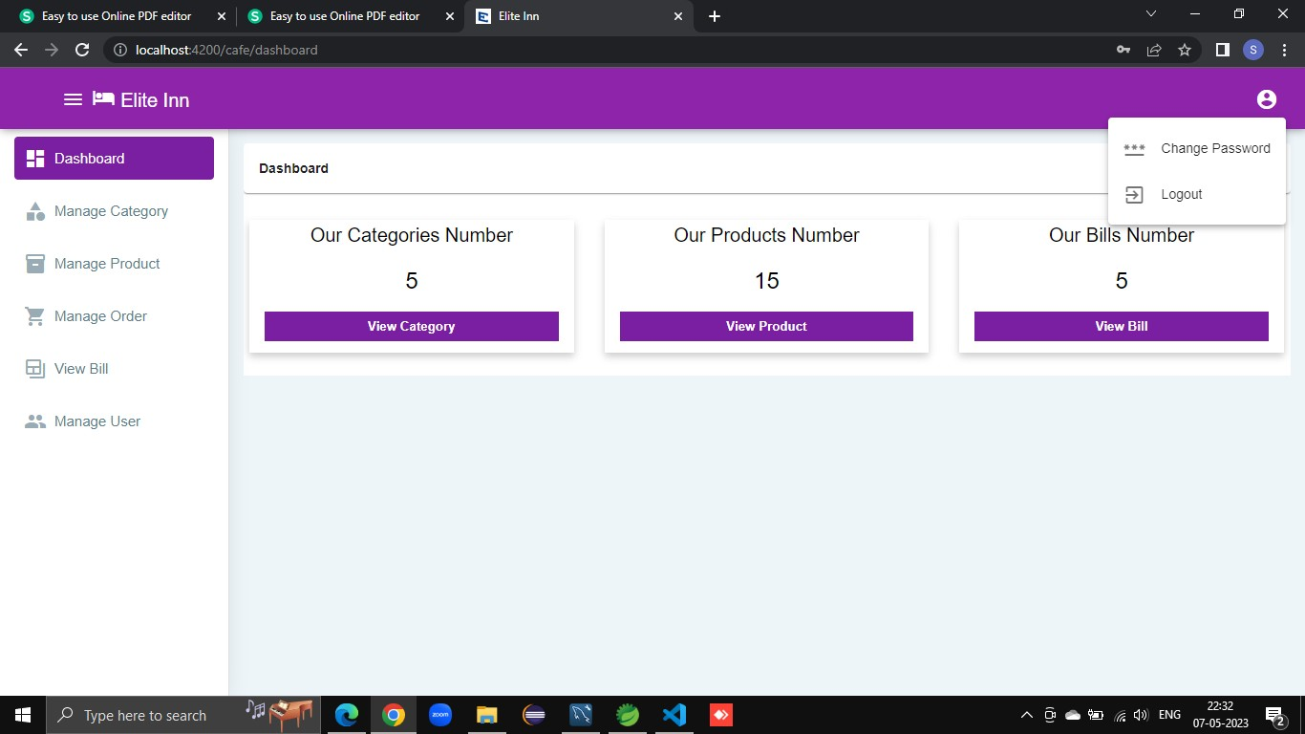
ELITE INN PROJECT ENTIRE MODULES
ADMIN MODULE
Manage Category
Manage Product
Manage Order
View Bill
Manage User
Change Password

Slide 4
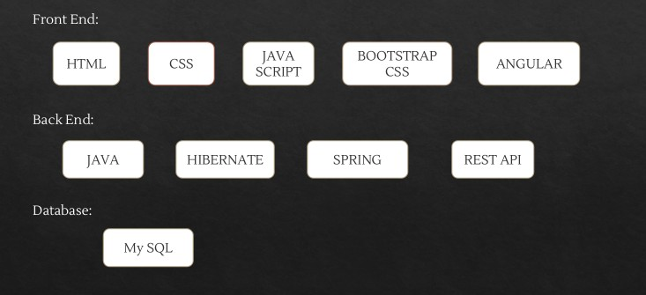
TECHNOLOGIES USED :
…….

Slide 5
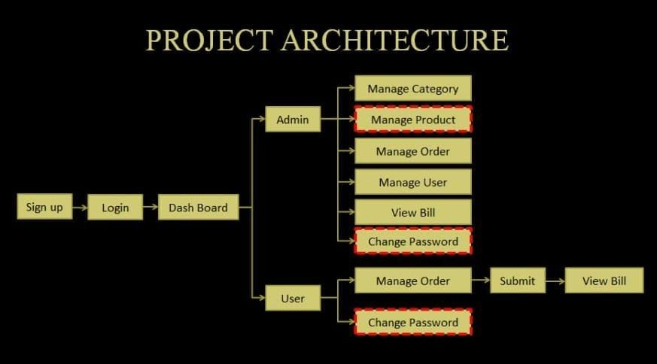
…….

Slide 6
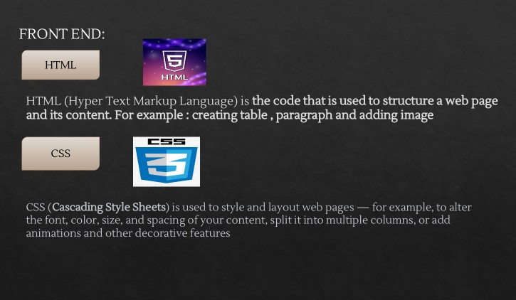


…….

Slide 7
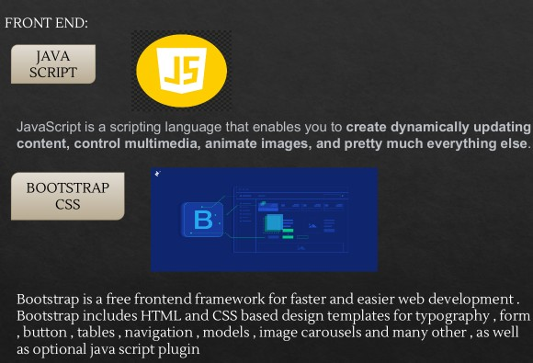



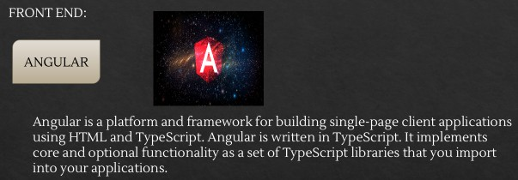
TypeScript is a free and open-source high-level programming language.
Developed by Microsoft that
adds static typing with optional type annotations to javascript.

Slide 8
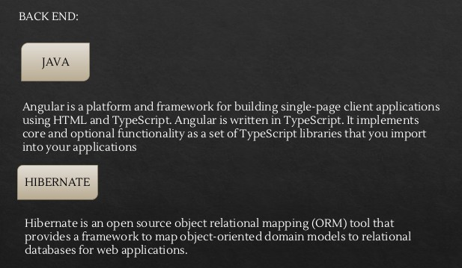
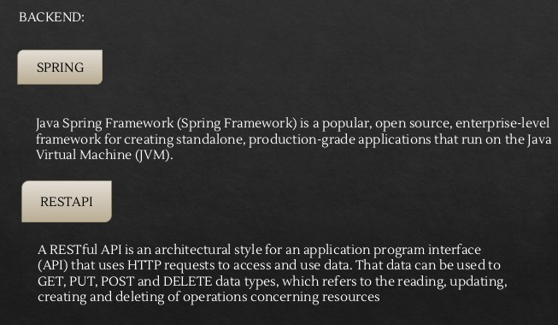
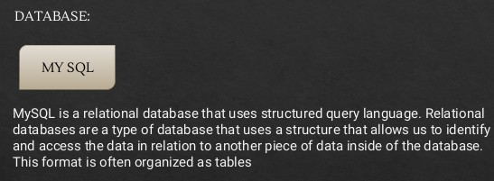

Slide 9
Manage Product (Admin Module) :
This Module is handled by the Admin.
The Admin can add or edit details of room from this module.
The Admin can activate or deactivate the rooms according to their availability.
The Admin can edit the price of the rooms according to their demand.
There is a filter option that allows the admin to search rooms using its name or categories.

Slide 10
Change Password (Admin & User Module) :
This allows User/Admin to change the Password when needed.
The User has to type the old/current Password, New Password, and Confirm Password for updating the New Password.
This can be updated only when the new password field matches the confirmed passsword.
The User and Admin can also View and see what they have typed.

Slide 11
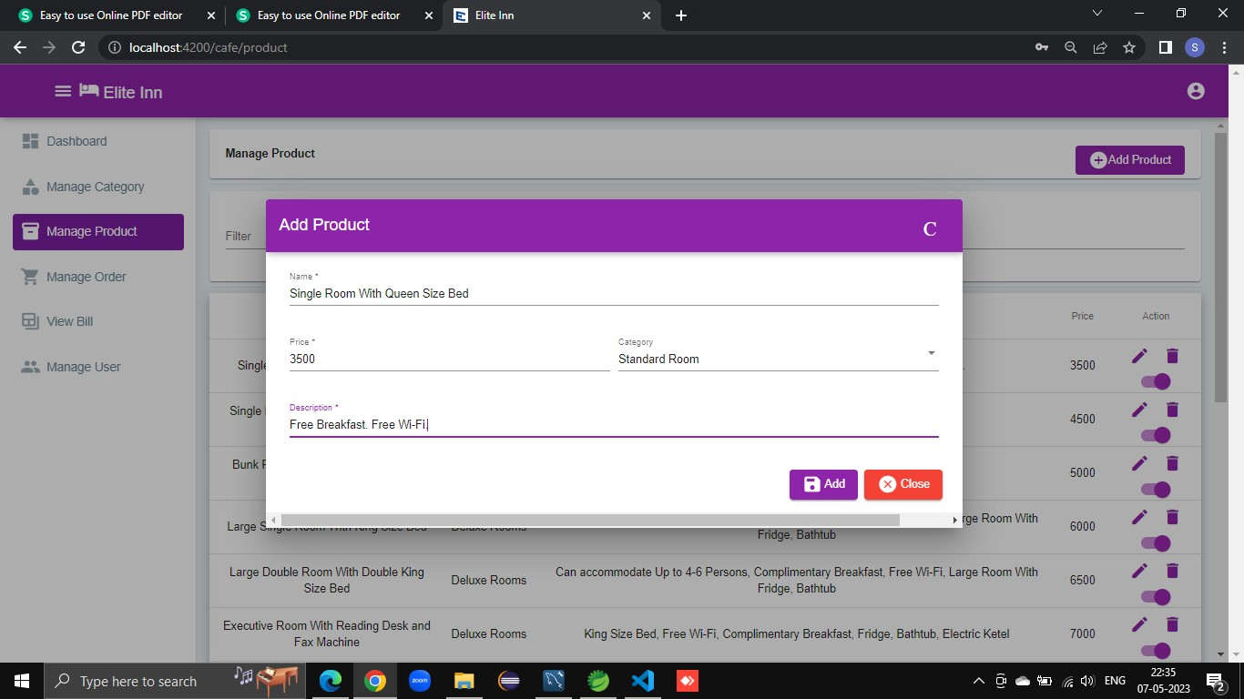
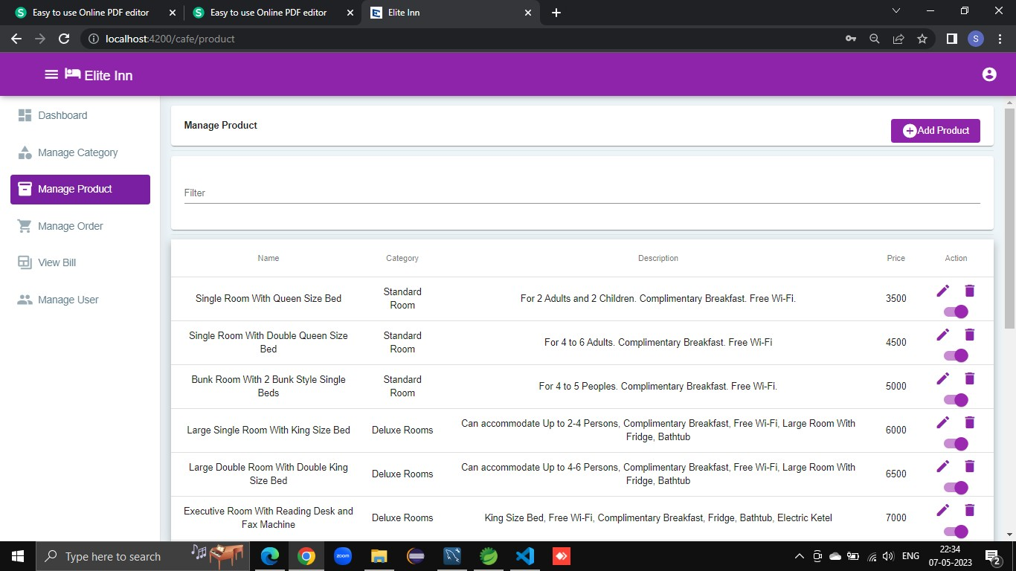
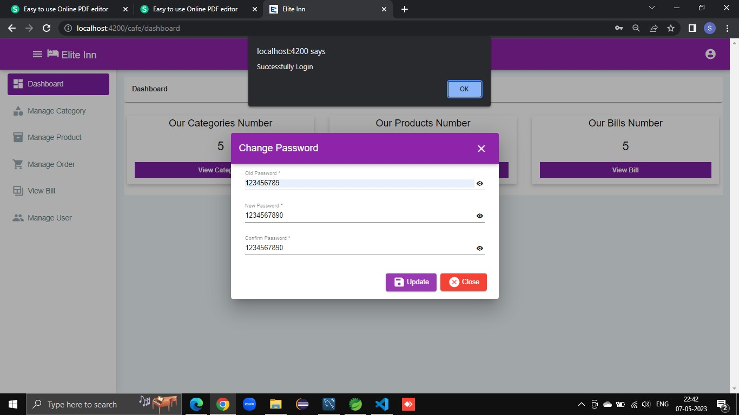
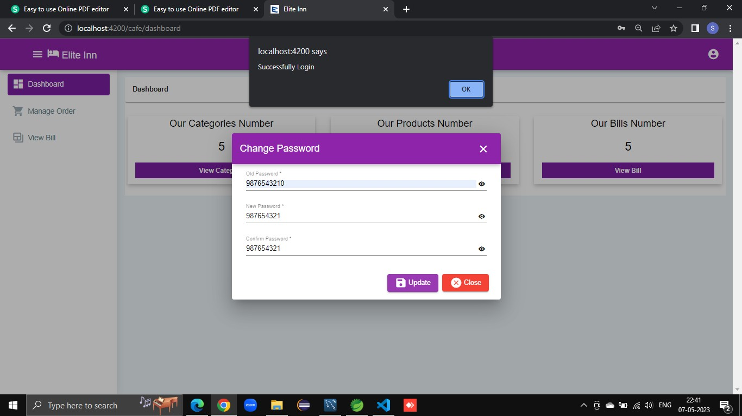
OUTPUT DEMO :
□

Slide 12
THANK YOU

